Slide 1
Optical Fiber Communications — Chapter 2 — — Optical fiber waveguides —

Slide 2
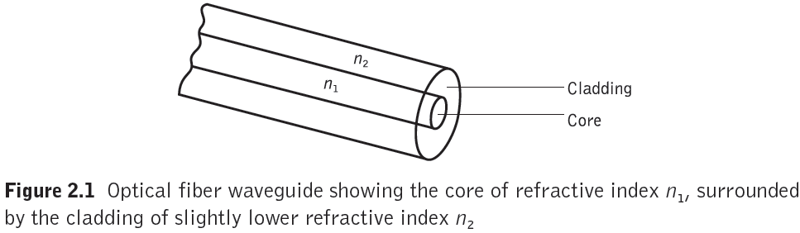
Optical fiber waveguides

Slide 3

Total internal reflection
The angles of incidence φ1 and refraction φ2 are related to each other and to the refractive indices of the dielectrics by Snell’s law of refraction which states that
n1 sin φ1 = n2 sin φ2
Or

Slide 4
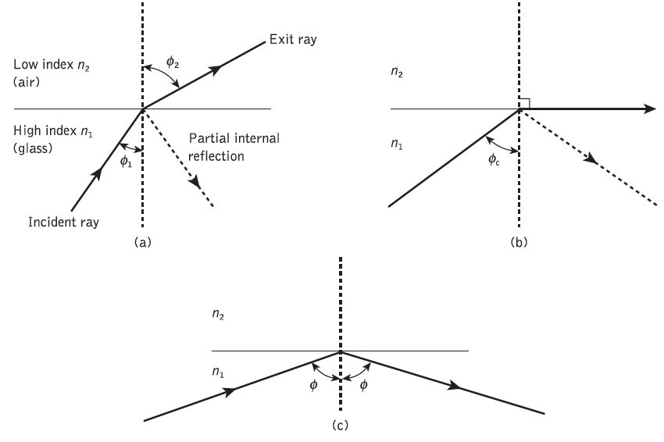
Light rays incident on a high to low refractive index interface (e.g. glass–air): (a) refraction

Slide 5
Light rays incident on a high to low refractive index interface (e.g. glass–air): (b) the limiting case of refraction showing the critical ray at an angle φc

Slide 6
Light rays incident on a high to low refractive index interface (e.g. glass–air): (c) total internal reflection where φ > φc

Slide 7

Total internal reflection
The value of the critical angle is given by
Data Mining: Concepts and Techniques

Slide 8
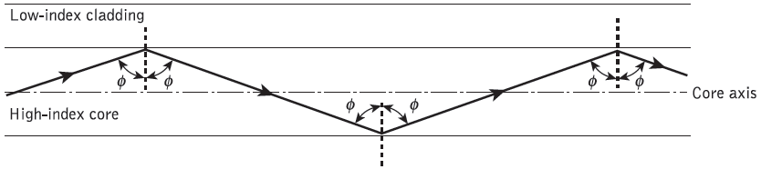
The transmission of a light ray in a perfect optical fiber
At angles of incidence greater than the critical angle the light is reflected back into the originating dielectric medium (total internal reflection) with high efficiency (around 99.9%).
Data Mining: Concepts and Techniques

Slide 9
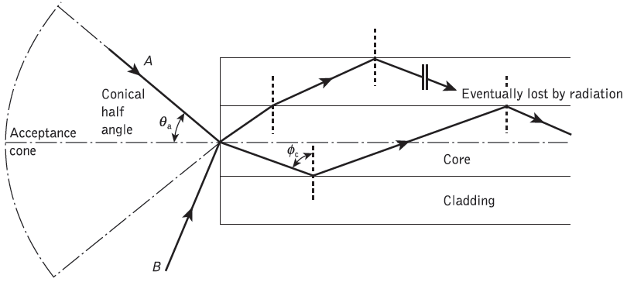
The acceptance angle θa when launching light into an optical fiber
Any rays which are incident into the fiber core at an angle greater than θa will be transmitted to the core–cladding interface at an angle less than φc, and will not be totally internally reflected.
θa is sometimes referred to as the maximum or total acceptance angle

Slide 10
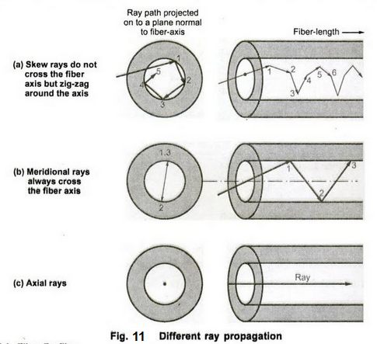
meridional rays vs Skew rays
Optical fiber waveguides

Slide 11
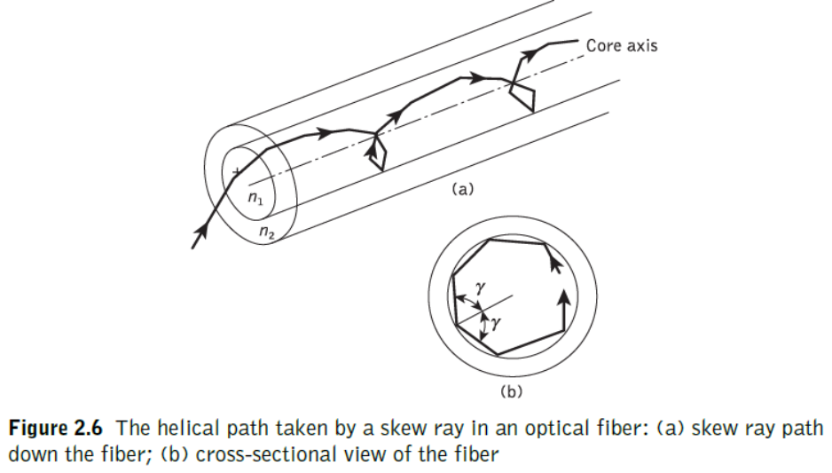
Optical fiber waveguides

Slide 12
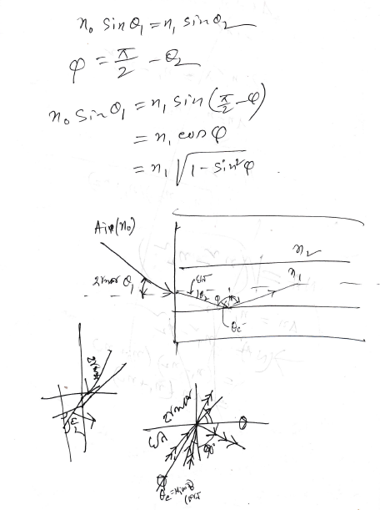
Data Mining: Concepts and Techniques

Slide 13
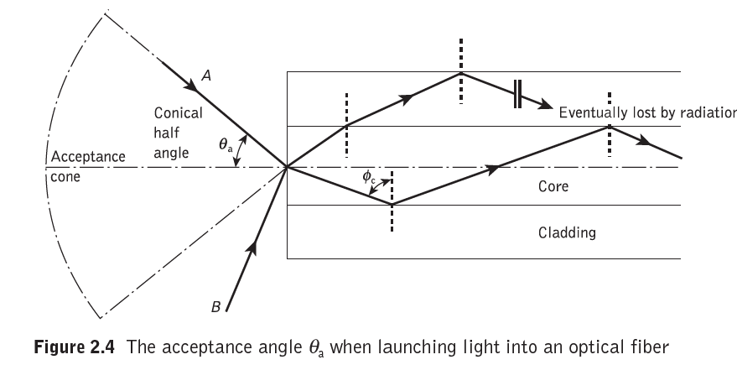
Data Mining: Concepts and Techniques

Slide 14
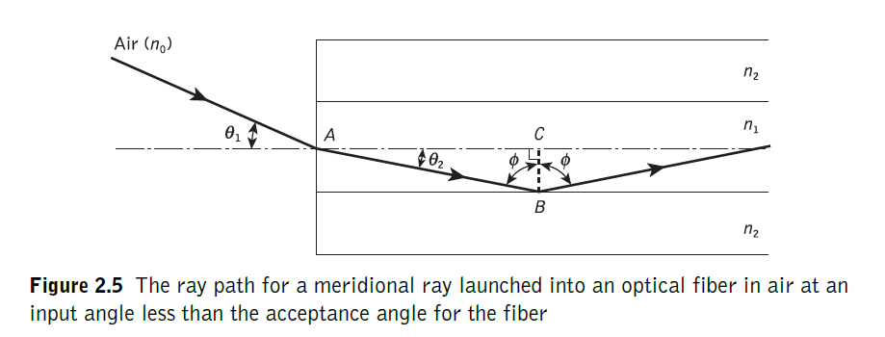
Data Mining: Concepts and Techniques

Slide 15
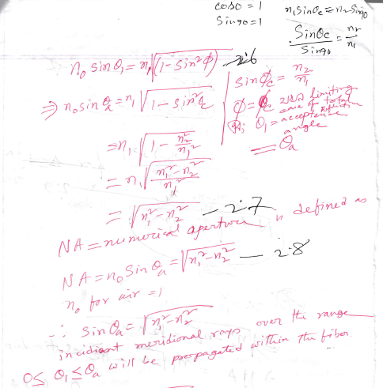
Data Mining: Concepts and Techniques

Slide 16

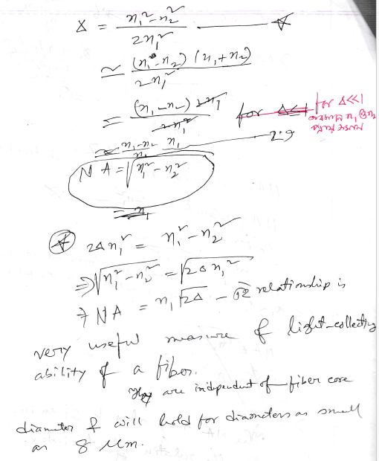
Data Mining: Concepts and Techniques

